Slide 1
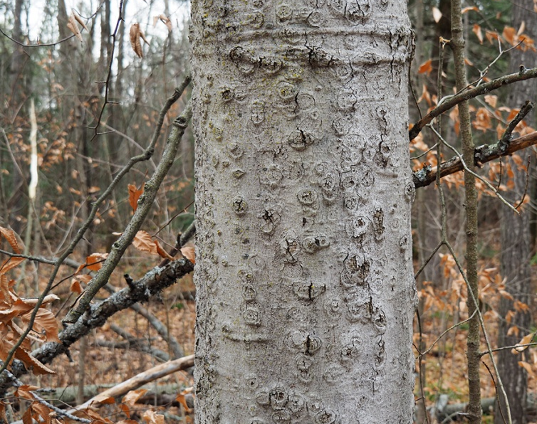
Phytohormone treatment of American beech across 3 sites in relation to Neonectria growth over dormant and growing season
Erin Reilly, Patrick Lemis

Slide 2
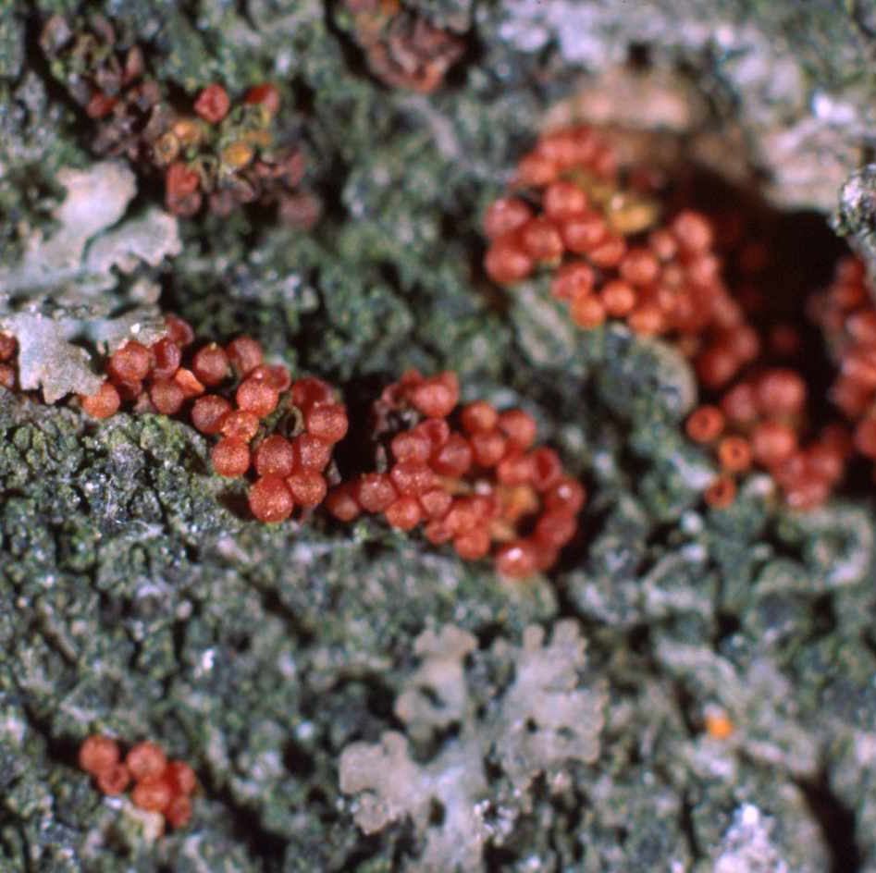
Intro
Beech bark disease
Neonectria faginata
Neonectria ditissima
Cryptococcus fagisuga
Phytohormones
Role in disease response
Methyl jasmonate
Salicylic acid

Slide 3
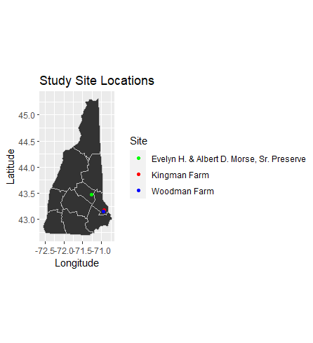
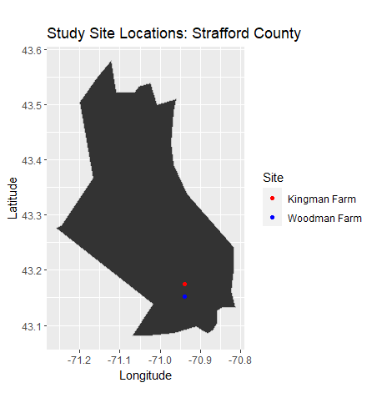
Design and Methods
3 sites
Evelyn H. & Albert D. Morse, Sr. Preserve (Alton, NH)
Kingman Farm (Madbury, NH)
Woodman Farm (Durham, NH)
36 trees/site
4 treatment classes
MJ
BTH
MJ+BTH
Control
2 inoculation times
Dormant season (Ei)
Growing season (Li)

Slide 4
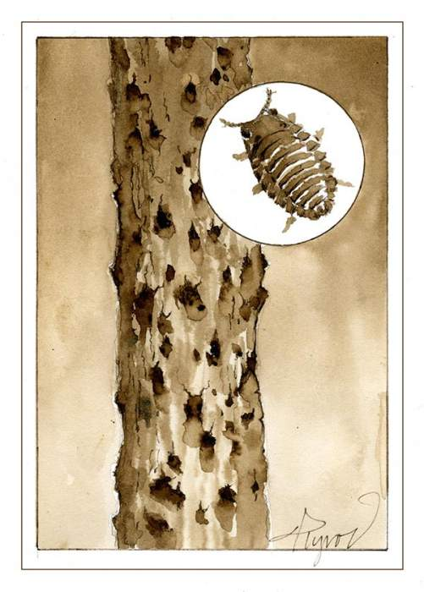
RESULTS:
Total Early and Late Inoculation by Treatment, Inoculation, and Harvest Time

Slide 5
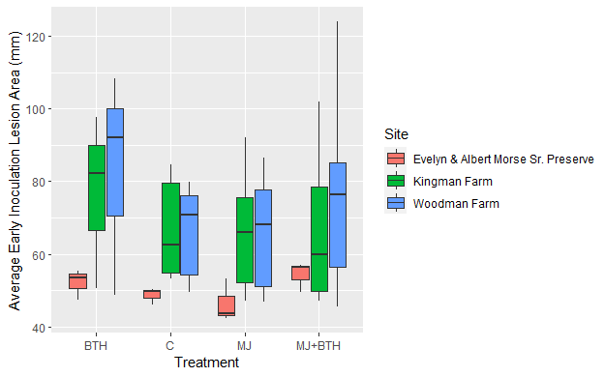
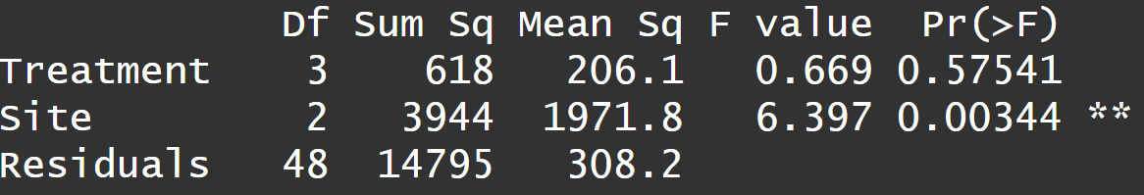
TotalEi, Treatment, Site

Slide 6
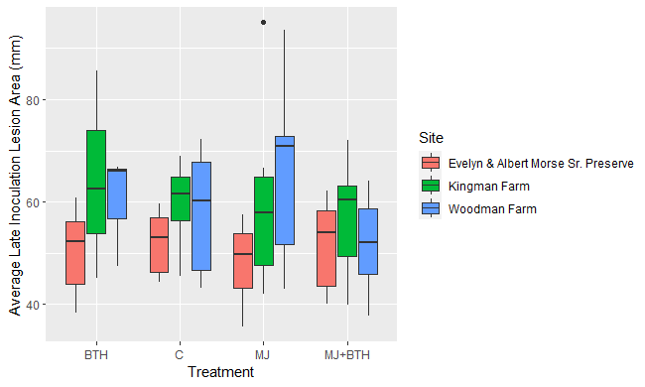
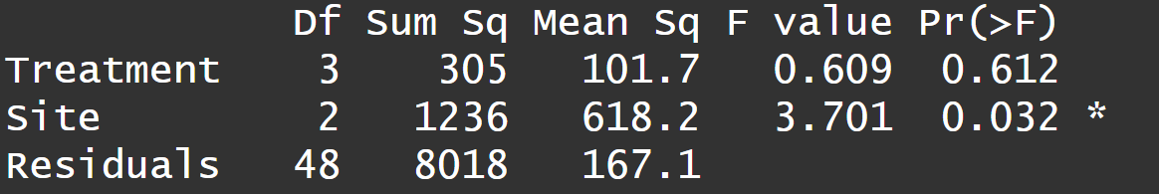
TotalLi, Treatment, Site

Slide 7
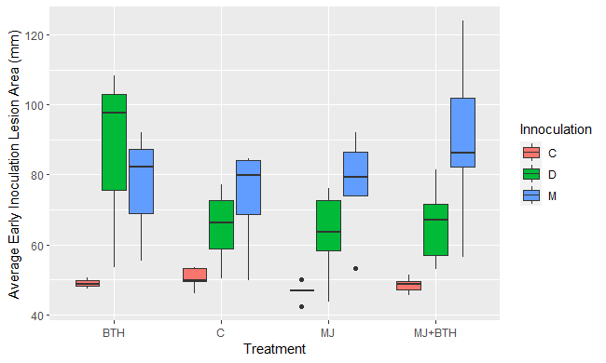
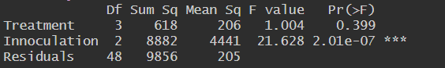
TotalEi, Treatment, Inoculation

Slide 8
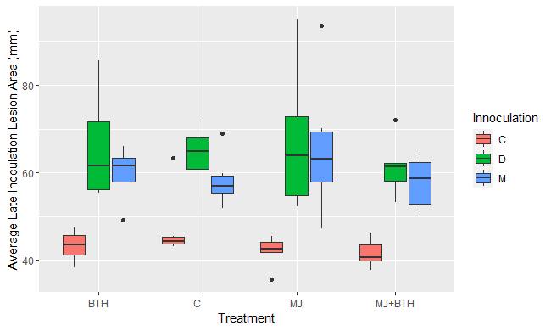
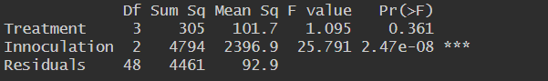
TotalLi, Treatment, Inoculation

Slide 9
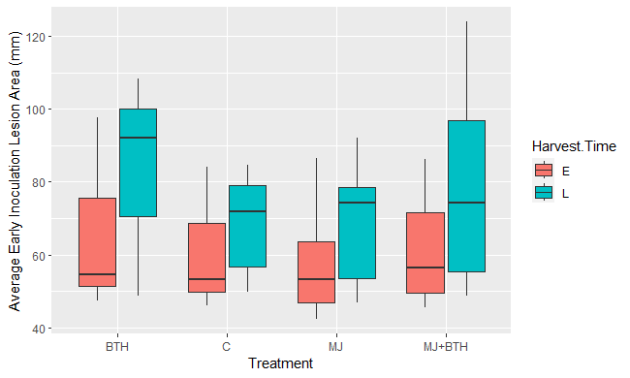
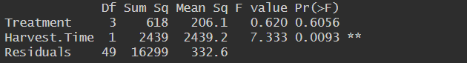
TotalEi, Treatment, Harvest.Time

Slide 10
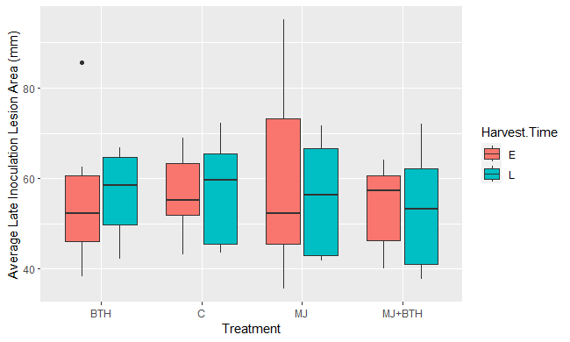
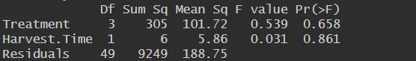
TotalLi, Treatment, Harvest.Time

Slide 11
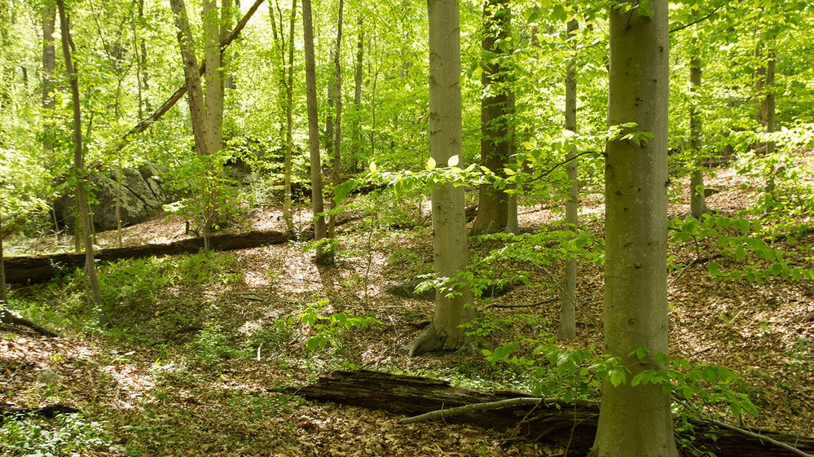
Conclusion:
Site has a significant effect on Neonectria lesion size (p value = 0.00344 & 0.032)
Genetic differences in different American beech populations
Potential environmental factors separation Alton and Strafford County sites
Inoculation has highly significant effect on Neonectria lesion size (p value = 2.01e-07 & 2.47e-8)
This may reflect different response to the two different species of Neonectria
N. faginata (M) is a specialist only found on Am. Beech, N. ditissima (D) is a generalist with many hardwood hosts
Harvest Time's significance (p value = 0.0093) in regard to early inoculation indicates that lesions continue to grow following dormancy break, as expected
Treatment did not have a significant effect on Neonectria lesion size overall
Investigation of each site independently not yet conducted

Slide 12
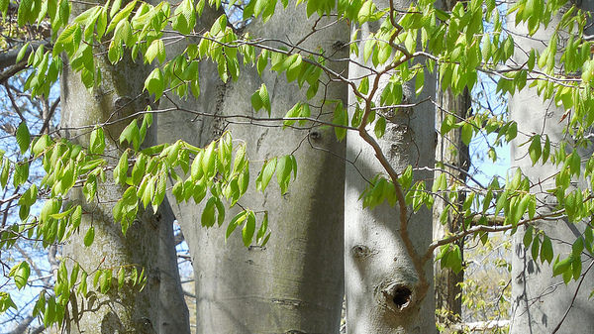
Questions?

